Slide 1
Types
slice, map, new, make, struct

Slide 2
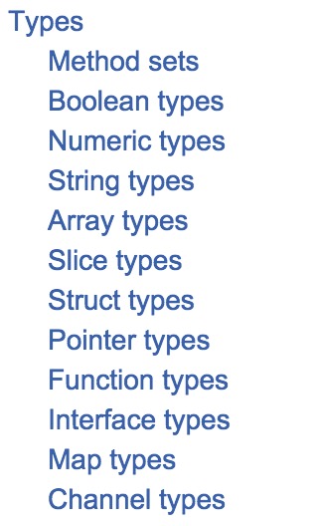
https://golang.org/ref/spec

Slide 3
slice
list

Slide 4
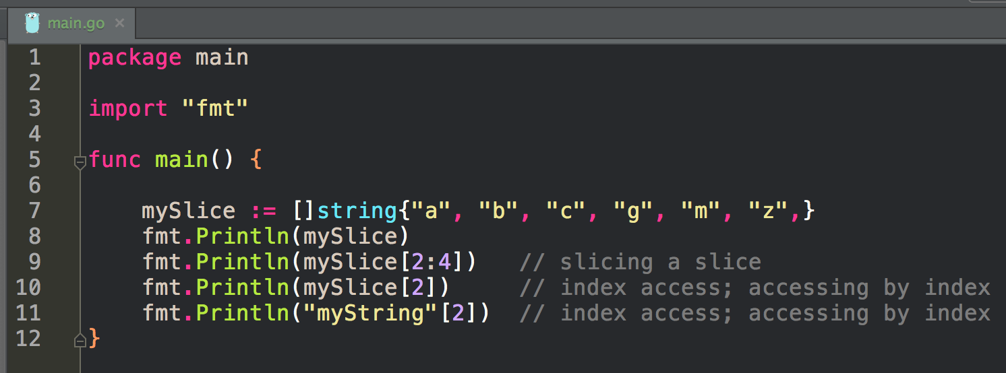
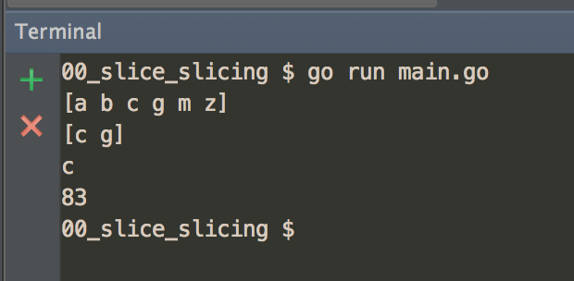
slice vs. slicing vs. index access

Slide 5
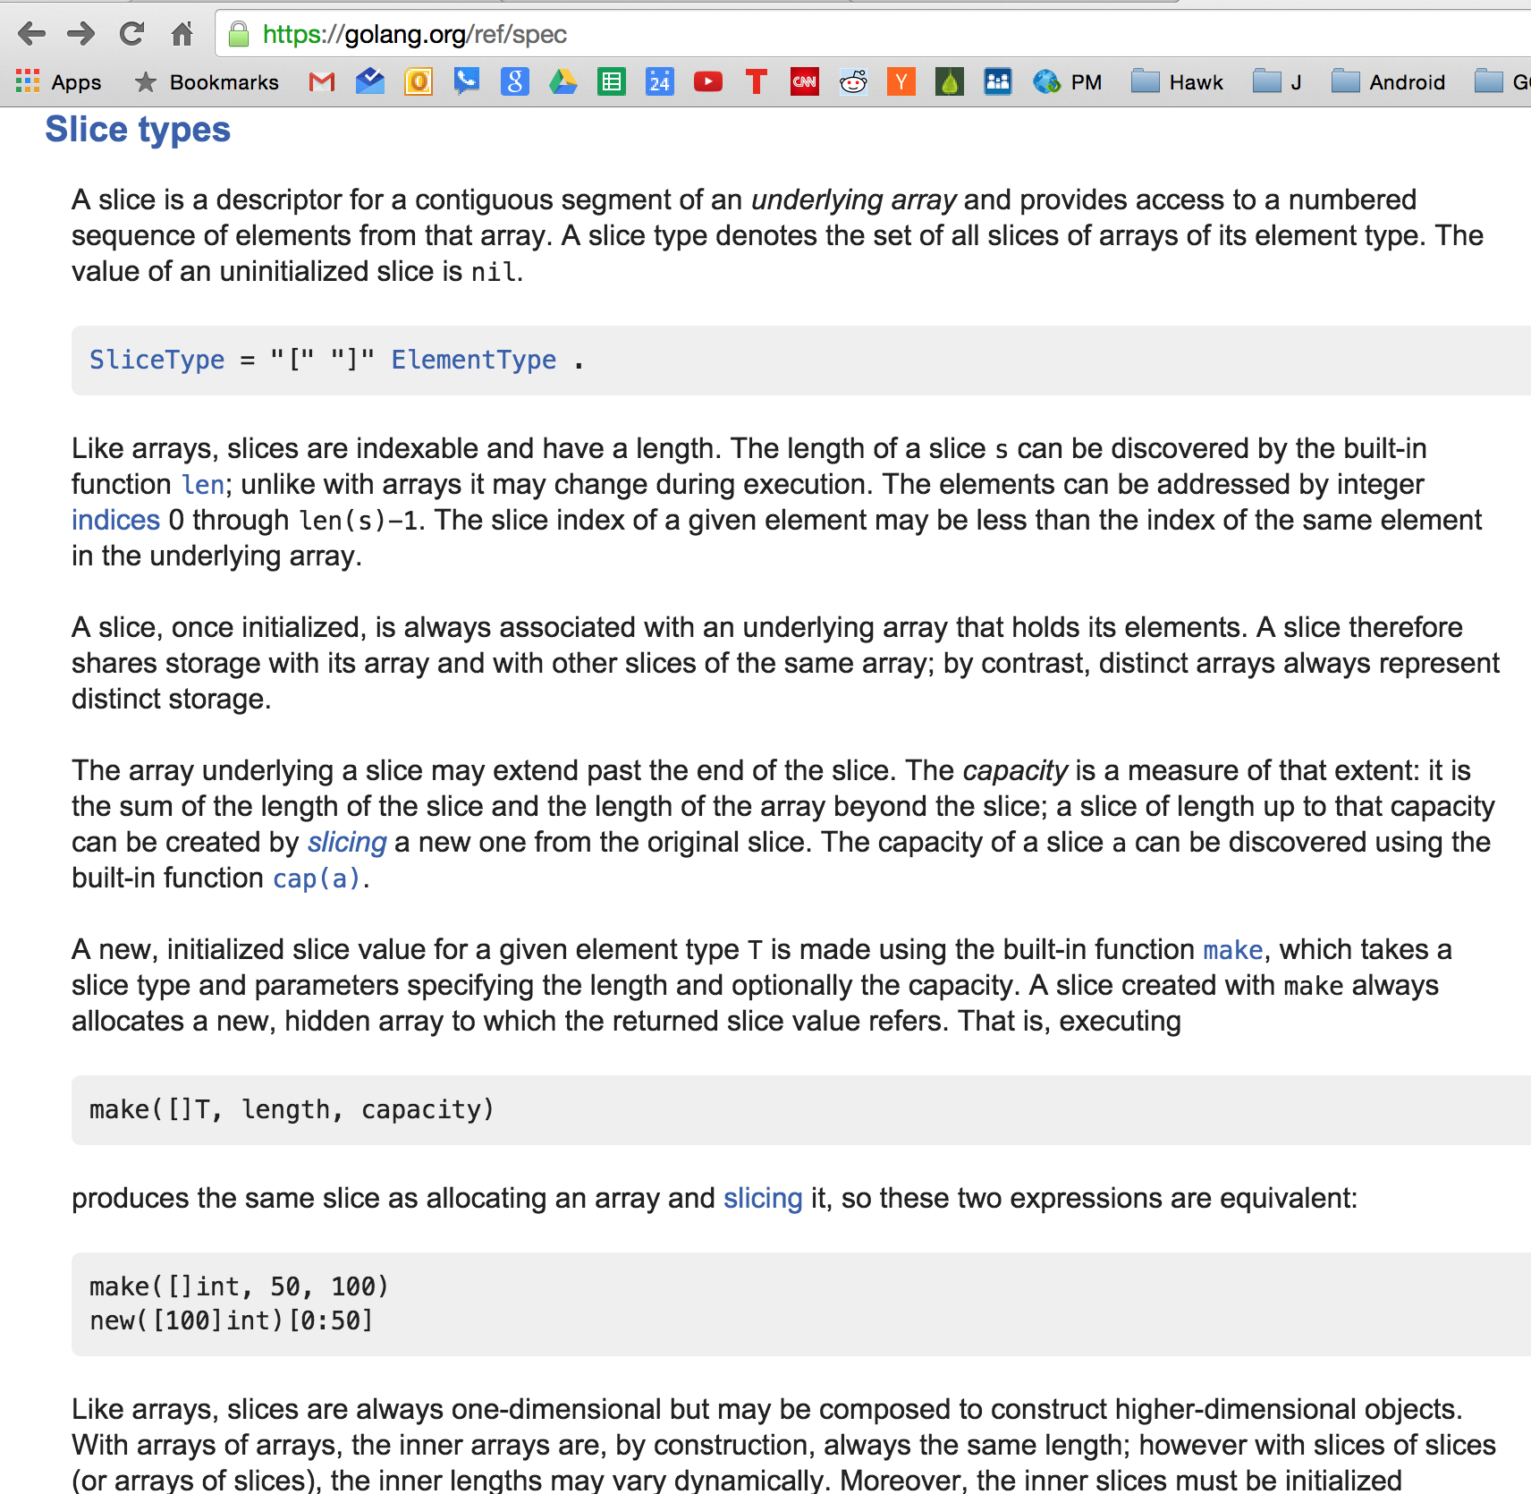


Slide 6
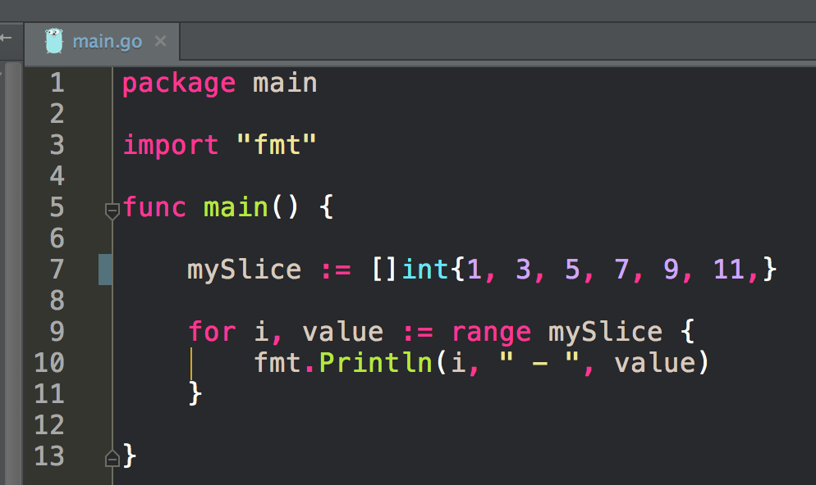
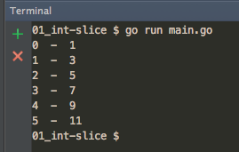
making a slice

Slide 7
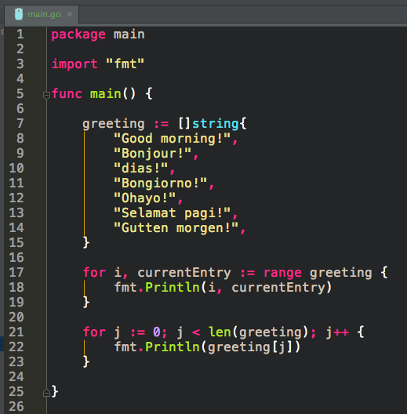
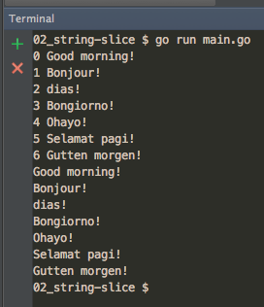
making a slice

Slide 8
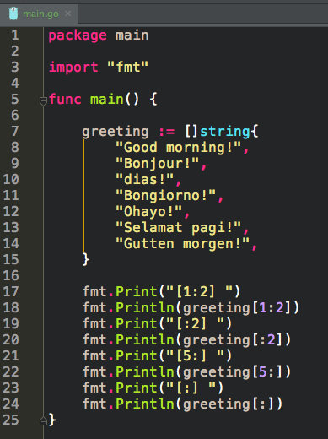
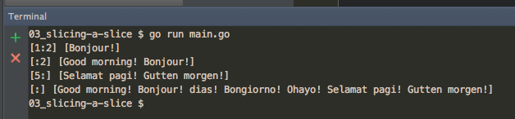
slicing a slice

Slide 9
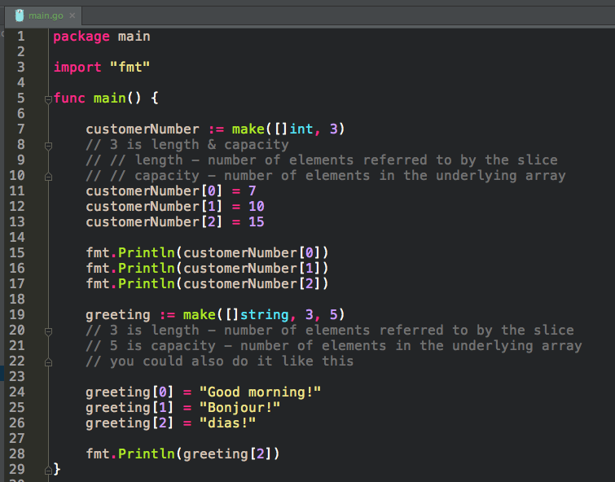
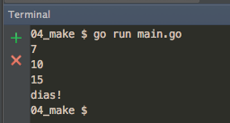
making a slice
If we think that our slice might grow, we can set a capacity larger than length. This gives our slice room to grow without golang having to create a new underlying array every time our slice grows. When the slice exceeds capacity, then a new underlying array will be created. These arrays double in size each time they’re created (2, 4, 8, 16) up to a certain point, and then they scale in some smaller proportion.

Slide 10
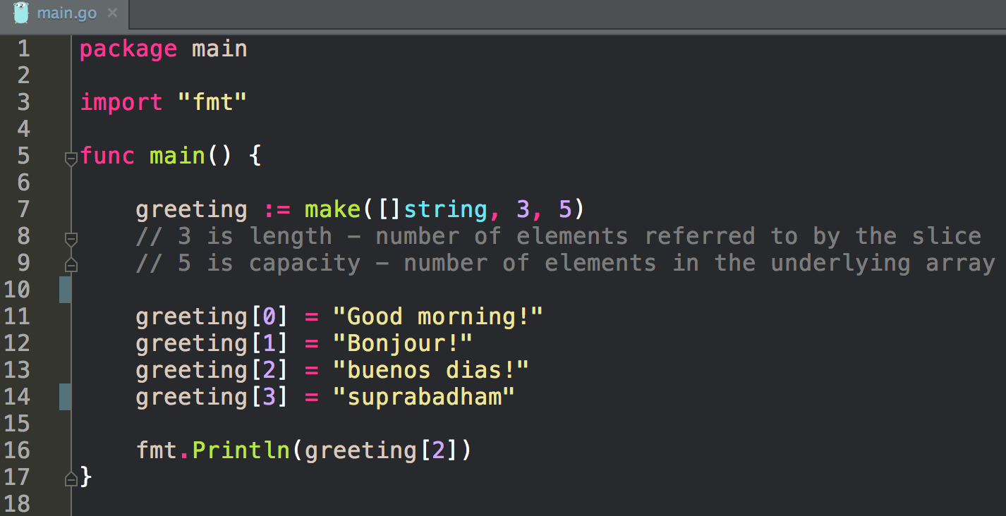
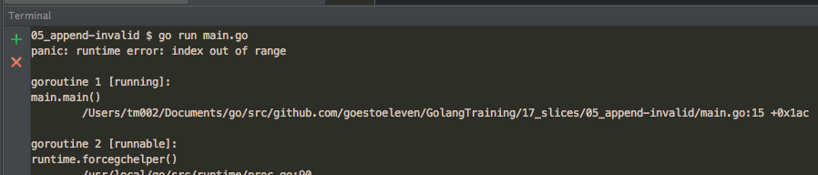
error
index out of range

Slide 11
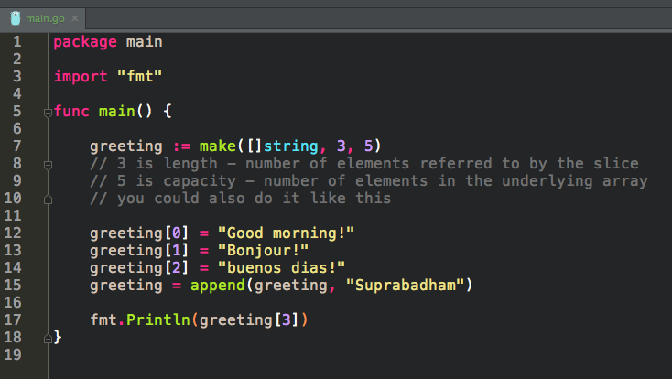
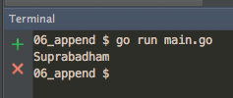
appending to a slice

Slide 12
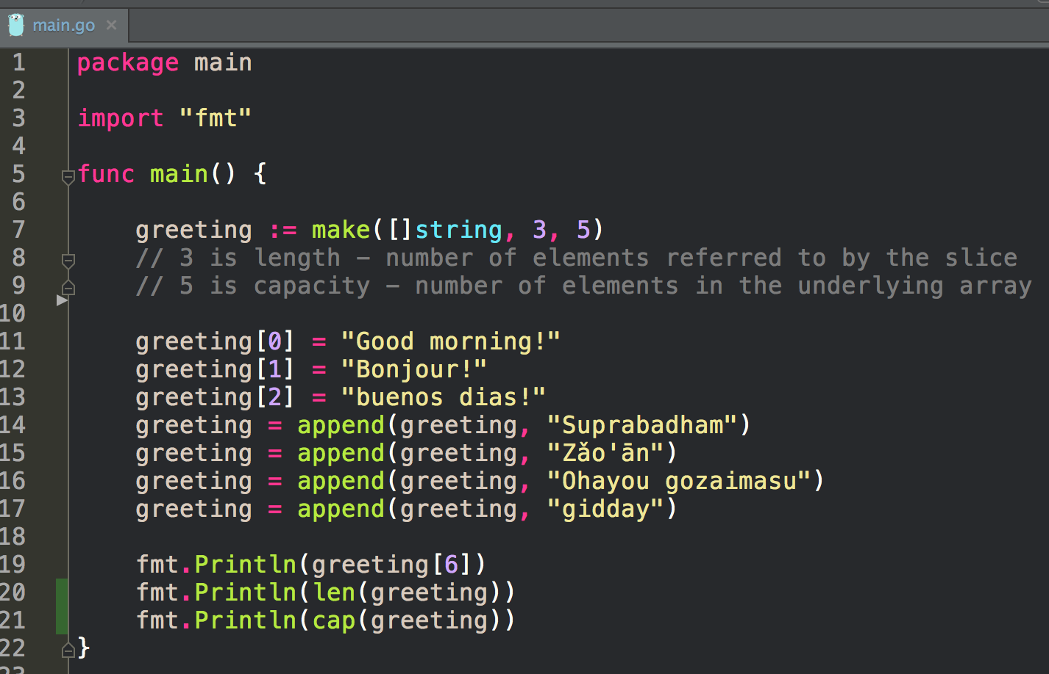
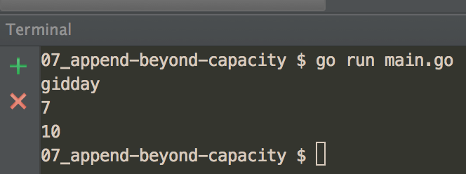
appending beyond capacity to a slice
If we think that our slice might grow, we can set a capacity larger than length. This gives our slice room to grow without golang having to create a new underlying array every time our slice grows. When the slice exceeds capacity, then a new underlying array will be created. These arrays typically double in size each time they’re created (2, 4, 8, 16).

Slide 13
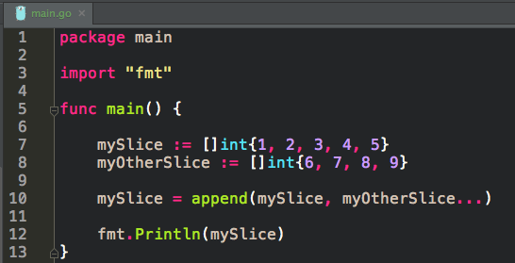
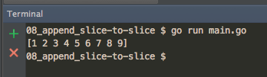
appending a slice to a slice
notice the syntax
args...

Slide 14
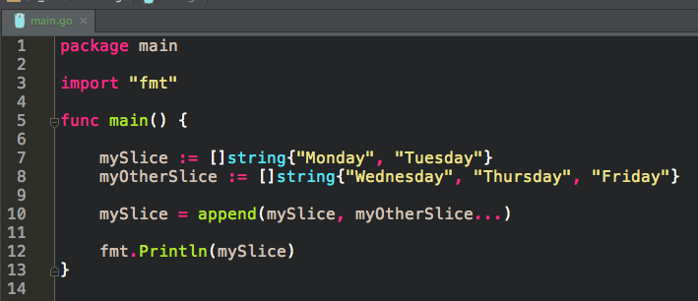
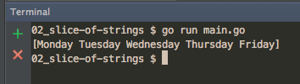
appending
a slice to a slice
notice the syntax

Slide 15
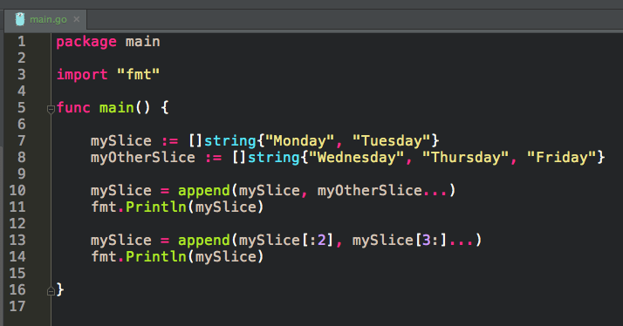
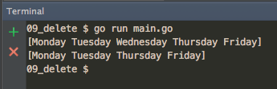
delete
from a slice

Slide 16
exercise
write a program that
creates a slice of ints using shorthand notation
then prints the slice

Slide 17
exercise
write a program that
creates a slice of strings using shorthand notation
then prints the slice

Slide 18
exercise
create a slice of ints using make;
set the length to 5 and capacity to 10

Slide 19
exercise
append a slice to a slice

Slide 20
exercise
delete an element from a slice

Slide 21
exercise
create a slice
then make your program throw an
“index out of range” error

Slide 22
map
key, value

Slide 23
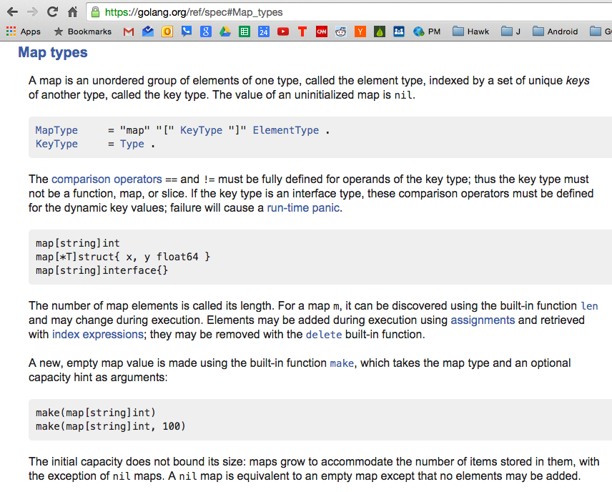
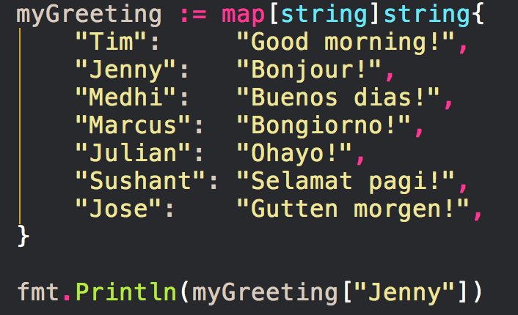
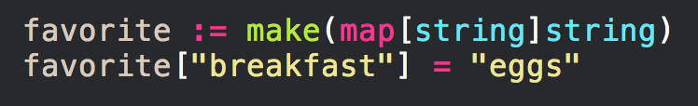

Slide 24
maps
basic info
key:value
maps keys to values
called “dictionaries” in some languages
built into the language (not an additional library you must import) so they’re first-class citizens
Map Keys
need to be unique
the type used for a key needs to have the equality operator defined for it
the type must allow equals comparisons
can’t use these types
slice
map
Maps are Reference Types
they behave like pointers
when you pass a map variable to a function
any changes to that mapped variable in the function
change that original mapped variable outside the function
Maps are Not Thread Safe
best to avoid using maps concurrently

Slide 25
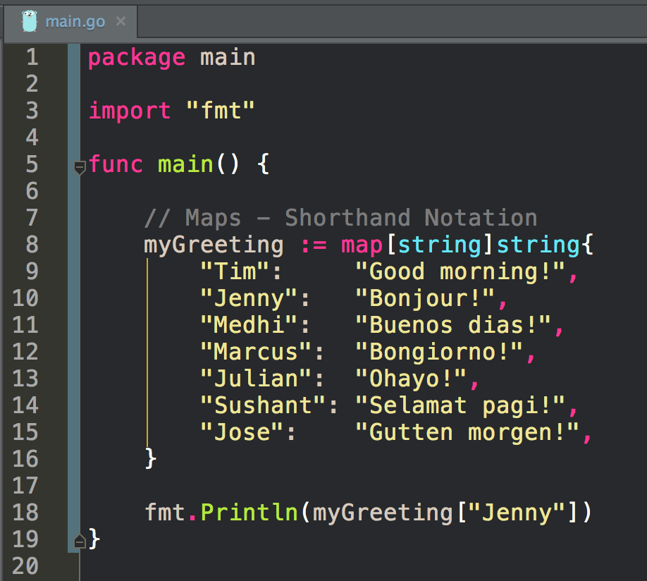
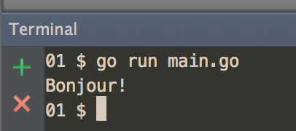
shorthand
for creating a map

Slide 26
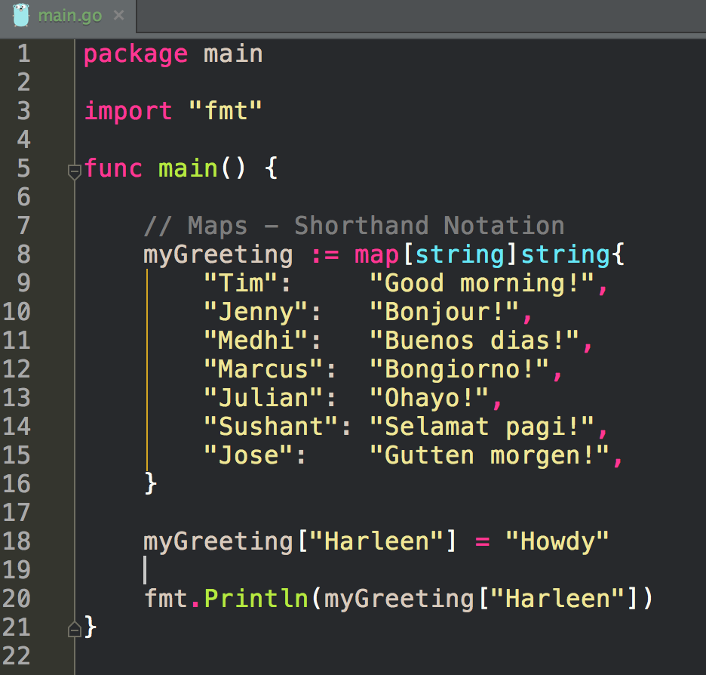
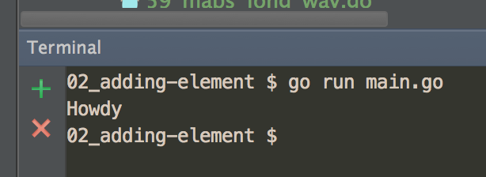
adding an entry
to a map

Slide 27
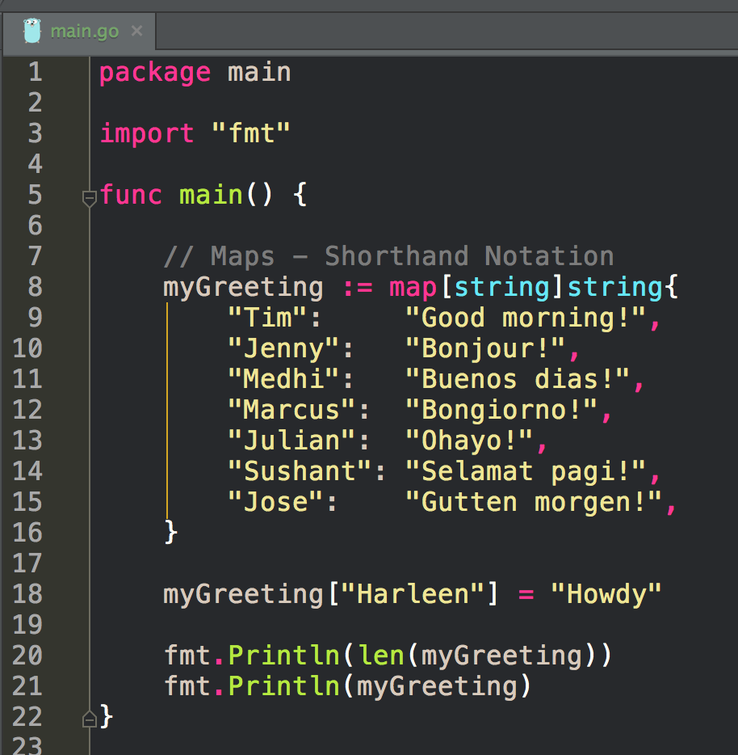
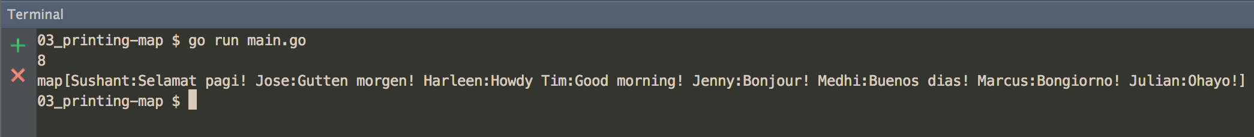
Printing map len
Printing map

Slide 28
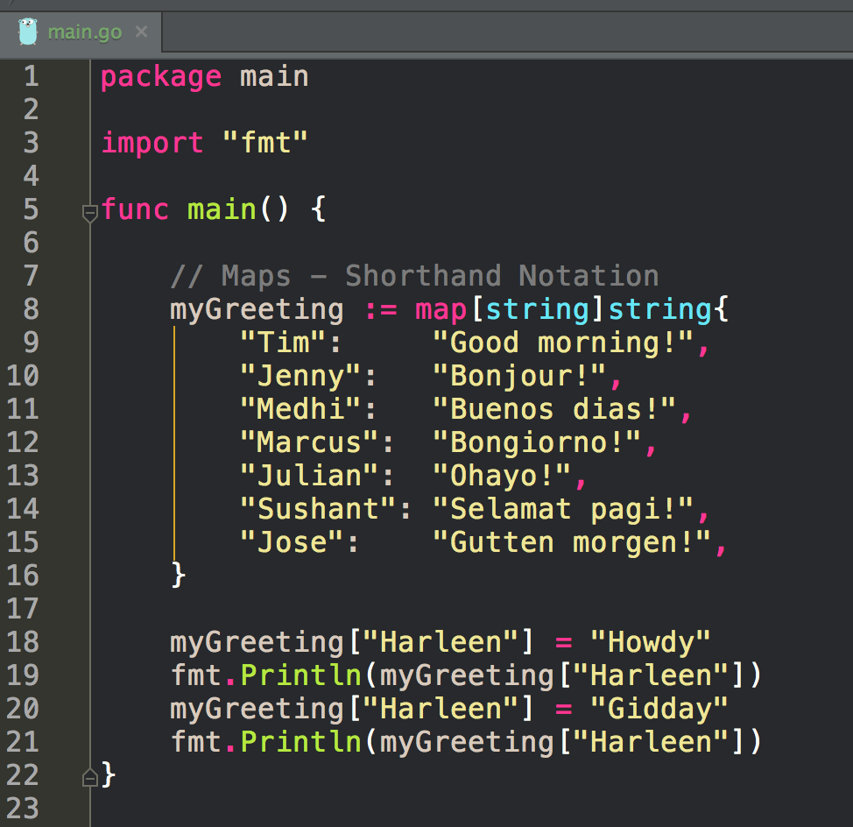
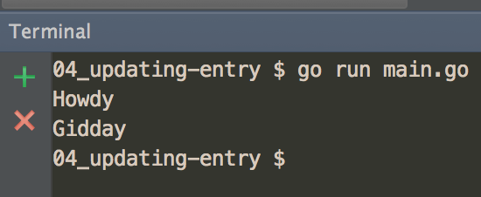
updating an entry

Slide 29
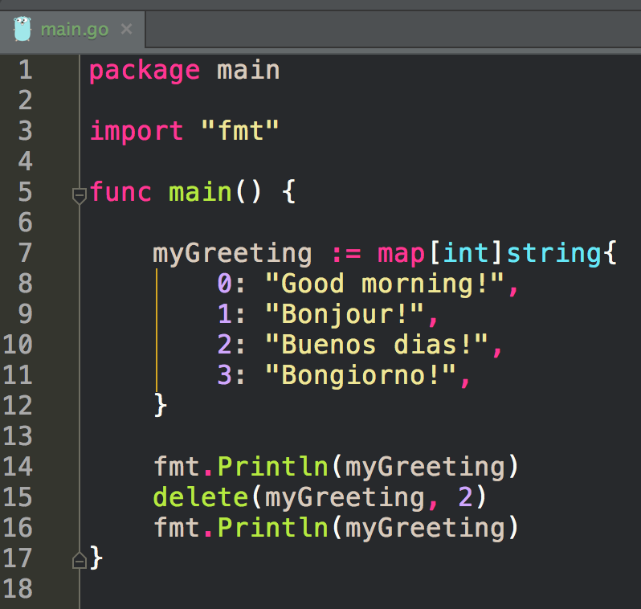
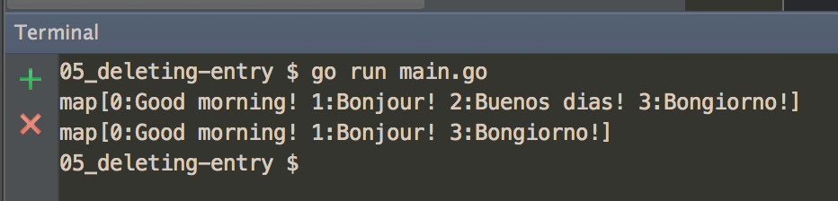
delete an entry

Slide 30
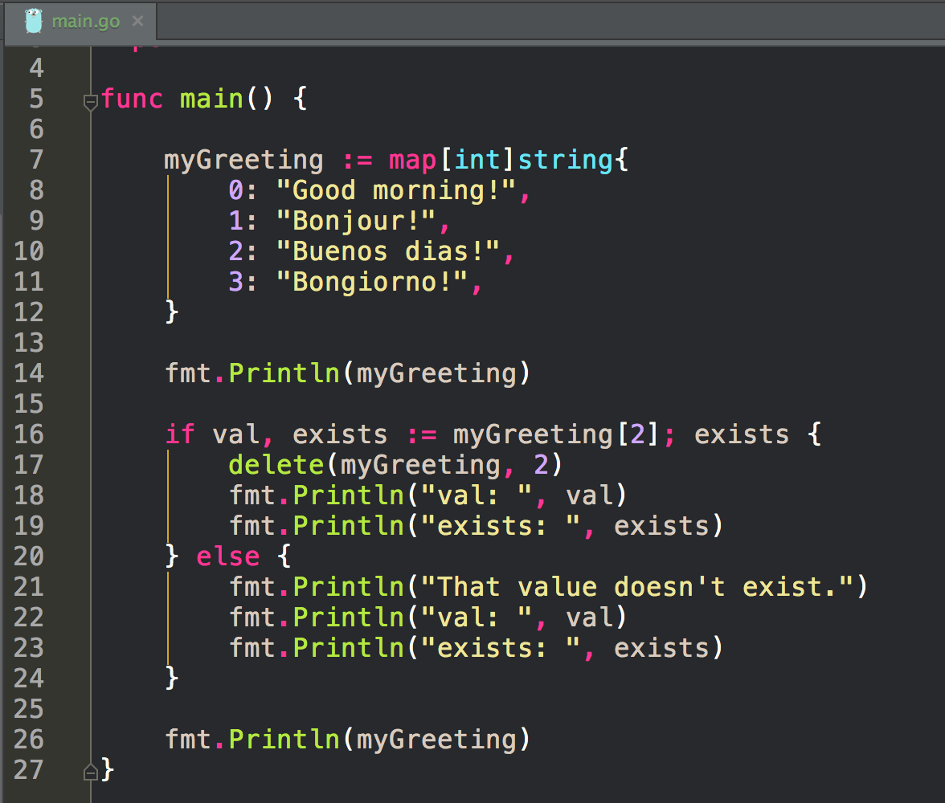
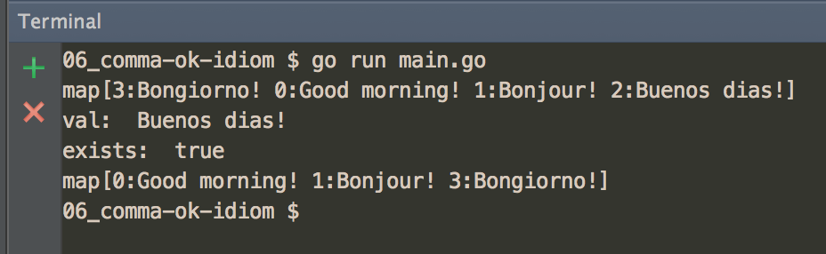
check for existence
comma ok idiom

Slide 31
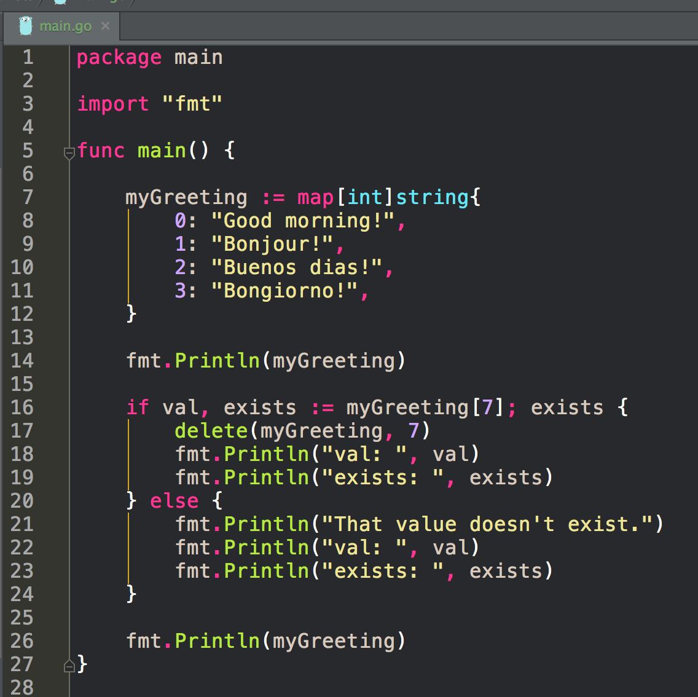
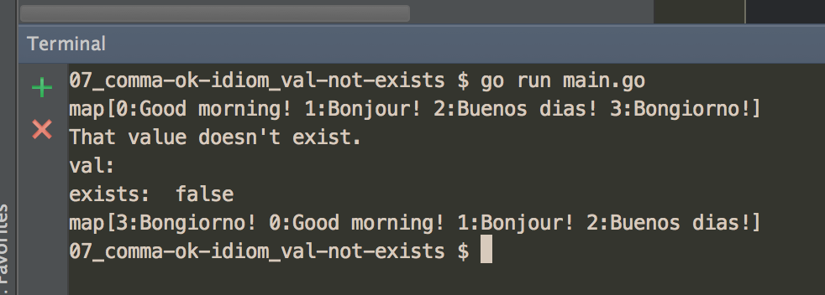
check for existence
comma ok idiom

Slide 32
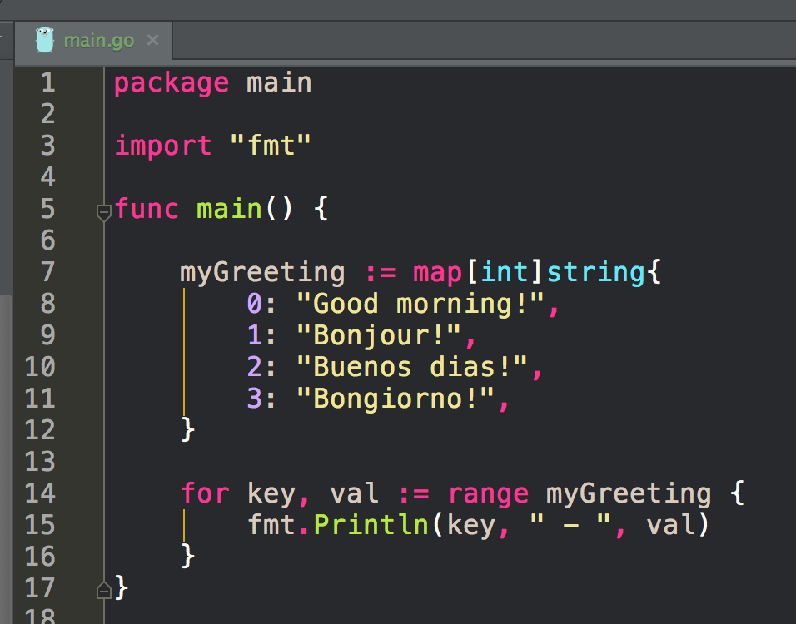
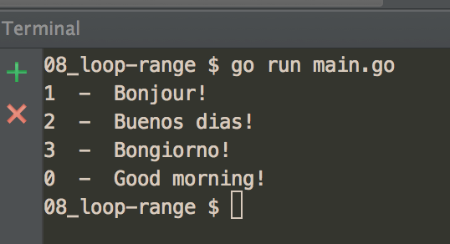
range loop

Slide 33
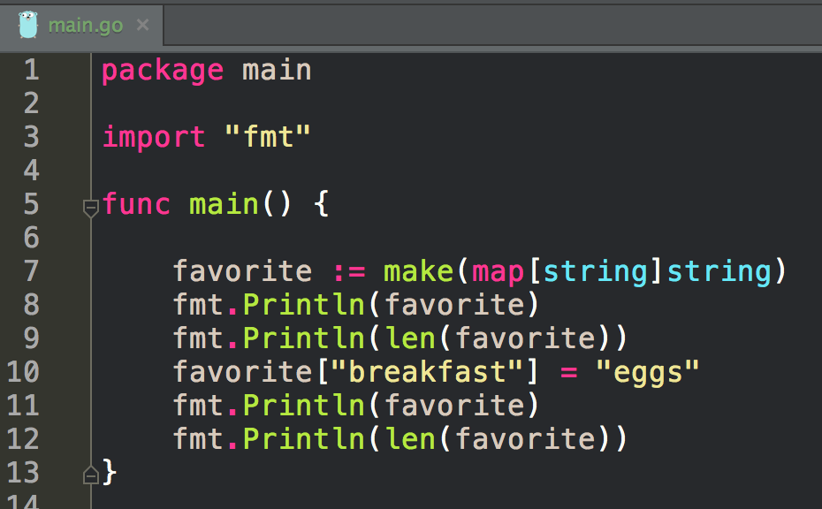
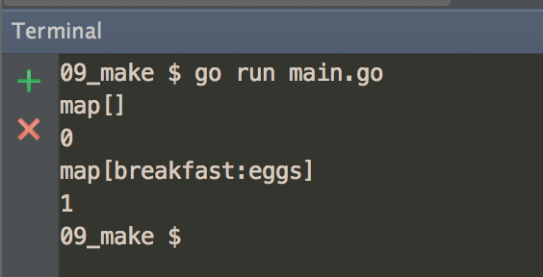
make
a map

Slide 34
exercise
create a program that:
creates a map using shorthand notation
adds an entry to the map
changes an entry in the map
deletes an entry in the map
prints all of the entries in the map using range
prints the len of the map
uses the comma ok idiom

Slide 35
make vs new

Slide 36
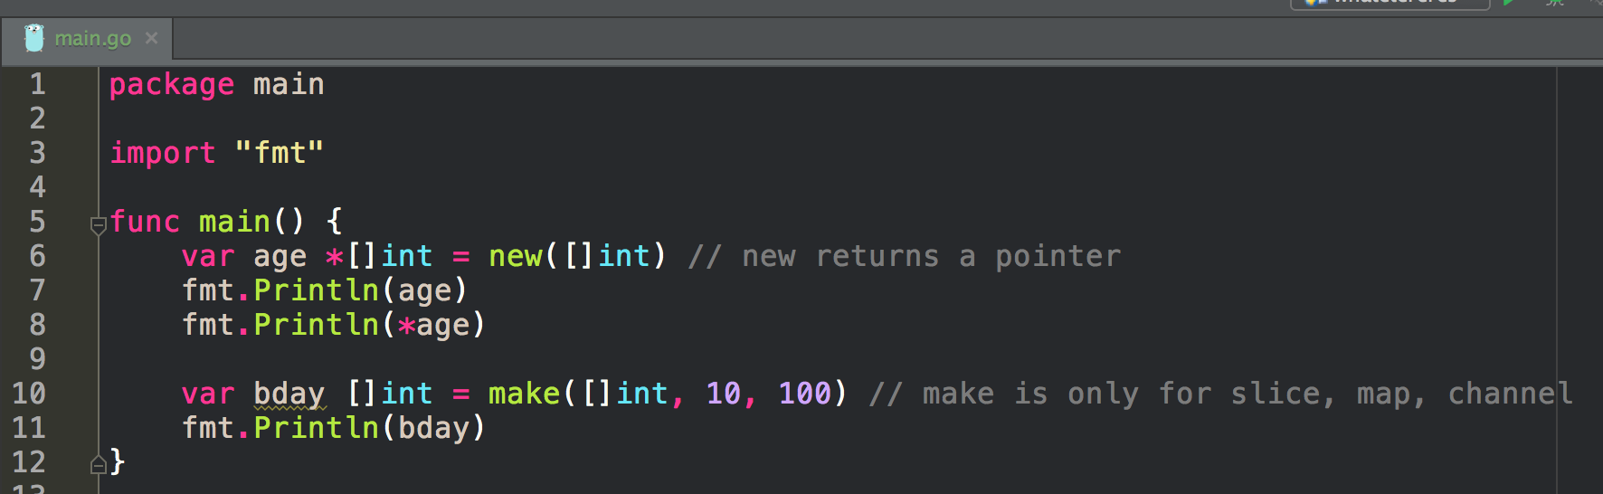
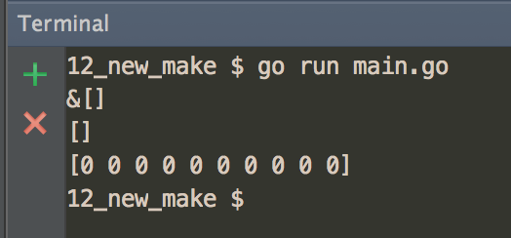
make vs new
make
slices, maps, channels
allocates memory
initializes
puts 0 or empty string into values
new
returns a pointer
newly allocated
zeroed value
“returns a pointer to a newly allocated zeroed value of type T”

Slide 37
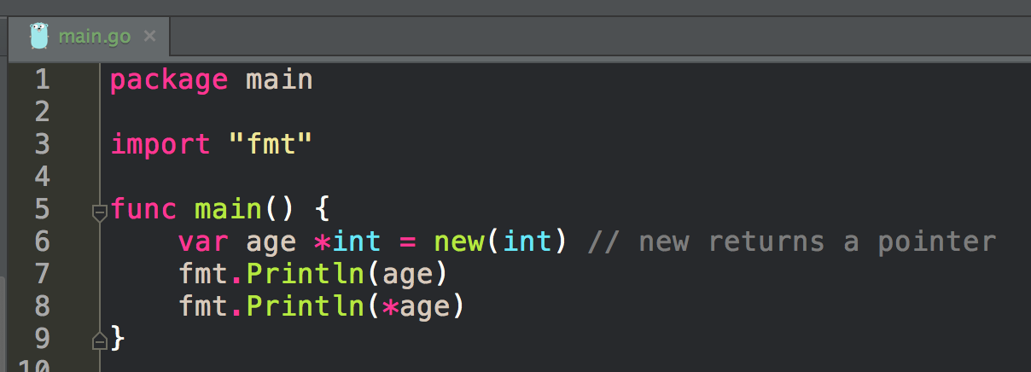
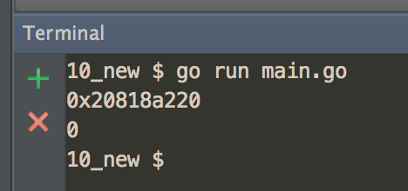
make vs new
make
slices, maps, channels
allocates memory
initializes
puts 0 or empty string into values
new
returns a pointer
newly allocated
zeroed value
“returns a pointer to a newly allocated zeroed value of type T”

Slide 38
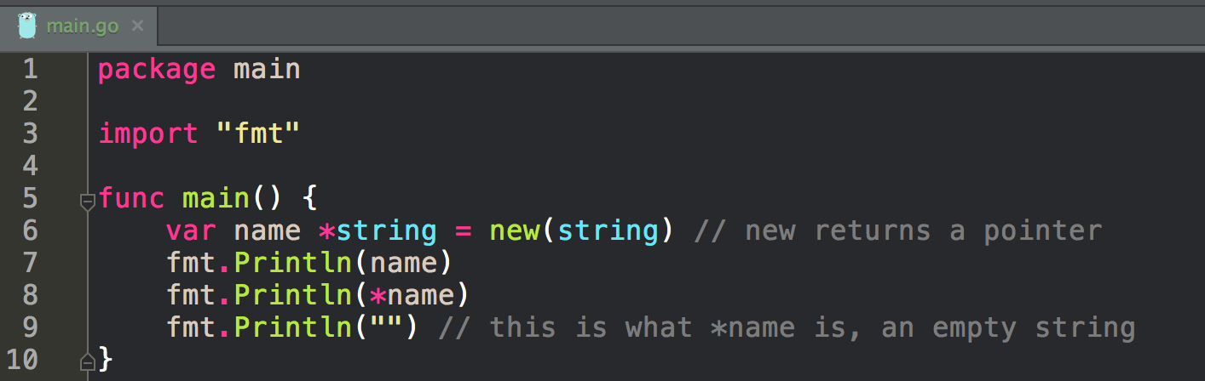

make vs new
make
slices, maps, channels
allocates memory
initializes
puts 0 or empty string into values
new
returns a pointer
newly allocated
zeroed value
“returns a pointer to a newly allocated zeroed value of type T”

Slide 39
zero value
false for booleans, 0 for integers, 0.0 for floats, "" for strings
nil for pointers, functions, interfaces, slices, channels, and maps
https://golang.org/ref/spec#The_zero_value

Slide 40


make vs new
make
slices, maps, channels
allocates memory
initializes
puts 0 or empty string into values
new
returns a pointer
newly allocated
zeroed value
“returns a pointer to a newly allocated zeroed value of type T”

Slide 41


make vs new
make
slices, maps, channels
allocates memory
initializes
puts 0 or empty string into values
new
returns a pointer
newly allocated
zeroed value
“returns a pointer to a newly allocated zeroed value of type T”

Slide 42


make vs new
make
slices, maps, channels
allocates memory
initializes
puts 0 or empty string into values
new
returns a pointer
newly allocated
zeroed value
“returns a pointer to a newly allocated zeroed value of type T”

Slide 43


make vs new
make
slices, maps, channels
allocates memory
initializes
puts 0 or empty string into values
new
returns a pointer
newly allocated
zeroed value
“returns a pointer to a newly allocated zeroed value of type T”
make
slices, maps, channels
allocates memory
initializes
puts 0 or empty string into values

Slide 44


make vs new
make
slices, maps, channels
allocates memory
initializes
puts 0 or empty string into values
new
returns a pointer
newly allocated
zeroed value
“returns a pointer to a newly allocated zeroed value of type T”

Slide 45


make vs new
make
slices, maps, channels
allocates memory
initializes
puts 0 or empty string into values
new
returns a pointer
newly allocated
zeroed value
“returns a pointer to a newly allocated zeroed value of type T”

Slide 46


make vs new
make
slices, maps, channels
allocates memory
initializes
puts 0 or empty string into values
new
returns a pointer
newly allocated
zeroed value
“returns a pointer to a newly allocated zeroed value of type T”

Slide 47


Slide 48


Slide 49
exercise
create a program that:
declares a variable of type int using new
(note: this is not idiomatic go code to create an int this way)
print out the memory address of the variable
print out the value of the variable
true or false:
new returned a pointer

Slide 50
exercise
create a program that:
declares a variable of type string using new
(note: this is not idiomatic go code to create a string this way)
print out the memory address of the variable
print out the value of the variable
true or false:
new returned a pointer

Slide 51
exercise
create a program that:
declares a variable of type bool using new
(note: this is not idiomatic go code to create a bool this way)
print out the memory address of the variable
print out the value of the variable
true or false:
new returned a pointer

Slide 52
exercise
create a program that:
declares a variable of type[]int using make
print out the value of the variable
true or false:
make returned a pointer

Slide 53
exercise
create a program that:
declares a variable of type map[int]string using make
print out the value of the variable
true or false:
make returned a pointer

Slide 54
exercise
What are the zeroed values for int, string, bool?

Slide 55
exercise
What are the zeroed values for slice and map

Slide 56
exercise
Explain the difference between make and new

Slide 57
struct
grouped fields

Slide 58


create a struct
and initialize it

Slide 59


accessing fields using
dot notation

Slide 60


initializing two variables
of type person struct

Slide 61


initialize a variable
naming the fields

Slide 62


initialize a variable
omitting fields

Slide 63


viewing the type
of p1
We have created our own type
which is interesting to think about!

Slide 64


taking the address of a struct
p1 is of type *person

Slide 65


new
returns a pointer
newly allocated
zeroed value
“returns a pointer to a newly allocated zeroed value of type T”

Slide 66
question
Can we use make with a struct?

Slide 67
question
no
make is for slices, maps, and channels
Can we use make with a struct?
make
slices, maps, channels
allocates memory
initializes
puts 0 or empty string into values

Slide 68



Slide 69



Slide 70


Slide 71
exercise
create a program that:
defines a struct type to hold customer info
initialize two variables using that struct type
uses dot-notation to print a field from each of the variables
changes the value of one of the fields
prints the changed field

Slide 72
exercise
Can you use new to create a variable of a struct type?

Slide 73
exercise
Can you use make to create a variable of a struct type?

Slide 74
Review
slice vs. slicing vs. index access
slice
list
mySlice := []int{1, 3, 5, 7, 9, 11}
greeting := make([]string, 3, 5)
greeting = append(greeting, "Hello")
mySlice = append(mySlice, myOtherSlice...)
mySlice = append(mySlice[:2], mySlice[3:]...)
map
key, value
key type, element type
initializing
myMap := map[int]string{<entries>}
otras := make(map[string]string)
adding new entry
otras[“new key”] = “new value”
changing entry
otras[“new key”] = “newer value”
delete entry
delete(otras, “new key”)
comma ok idiom
if val, ok := myGreeting[2]; ok {
fmt.Println("val: ", val)
fmt.Println("exists: ", exists)
}
make
slices, maps, channels
allocates memory
initializes
puts 0 or empty string into values
new
returns a pointer
newly allocated
zeroed value
“returns a pointer to a newly allocated zeroed value of type T”
struct
grouped fields
type person struct { name string age int }
p1 := person{name: "James"}

Slide 75
Review Questions

Slide 76
slice
Why would you want to use make when creating a slice?

Slide 77
slice vs map vs struct
Describe the difference between the above data structures. Give an example of data that would be stored in each type.

